Slide 1
Video
Interview ??

Slide 2
Project Idea
Project Idea ?
Plag – Minimizer
(Minimize Plagiarism)

Slide 3
Project Idea
Plag-Minimizer
Web Interface
File Name
Browse File....
Email Id
psrana@gmail.com
Pay
Rs 10
Submit

Slide 4
Project Idea
How to start ?
Go to Youtube and search for
siraj raval text summarization
siraj raval text analytics
the coding train text analytics
the coding train text summarization
Explore as much as possible………

Slide 5
Testing of new Data Set in Rattle
Testing of new Data Set in Rattle….

Slide 6
Multi-Class Classification using Rattle
Open Rattle
library(rattle)
rattle()
Run for “Sample3 - Wine Quality.csv”
(Multi – Class Data)
Dataset is present in “Sample Dataset” folder of Day-04.

Slide 7
Binary -Class Classification using Rattle
Open Rattle
Run for “Sample5 - Brest Cancer.csv”
(Binary Classification Data)
Dataset is present in “Sample Dataset” folder of Day-04.

Slide 8
Run R Program
Run R Program through Command line
For windows
rscript <R Program Name>
Example → rscript randomForest.r
For Linux/Mac
Rscript randomForest.r

Slide 9
Run R Program
Set the path for rscript in “Environment variable”
Copy the path of rscript
C:\Program Files\R\R-3.5.0\bin
OR
C:\Program Files (x86) \R\R-3.5.0\bin
Paste into Environment variable

Slide 10
Run R Program
Run R Program through Command line of Day-06
rscript randomForest.r
rscript decisionTree.r
rscript linearModel.r
rscript neuralNetwork.r

Slide 11
Multi-Class Classification with R Coding
Go to
04 - Practical Session on R →
Session IV - Classification - Multiclass →
Explore classificationDataSetMultiClass.csv
Open randomForest.R with RStudio

Slide 12
Multi-Class Classification with R Coding
Run R Program through Command line of Day-07
rscript randomForest.r
rscript decisionTree.r
rscript linearModel.r
rscript neuralNetwork.r
rscript svm.r

Slide 13
Multi-Class Classification with R Coding
Go to
04 - Practical Session on R →
Session IV - Classification - Multiclass →
Open svm.r with Rstudio
Run the program.

Slide 14
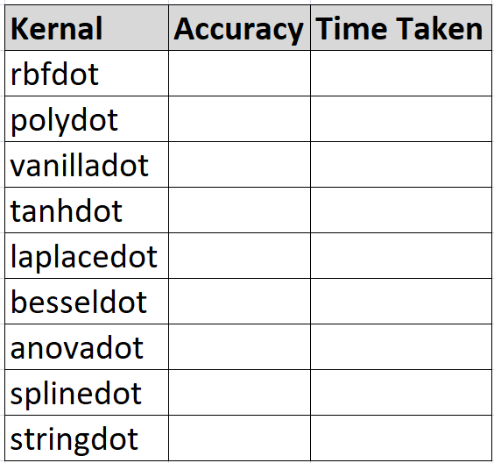
Multi-Class Classification with R Coding
Parameter Optimization of SVM
Choosing the right Kernel

Slide 15
Paper writing on Multi-Class Classification
Go to
04 - Practical Session on R →
Session IV - Classification - Multiclass →
Open Multi Class Classification Paper.pdf

Slide 16
Testing of new Data Set
Do it yourself

Slide 17
Binary Classification with R Coding
Go to
04 - Practical Session on R →
Session V - Classification - Binary Class →
Explore brestCancer.csv
Open randomForest.R with RStudio

Slide 18
Paper writing on Binary-Class Classification
Go to
04 - Practical Session on R →
Session V - Classification – Binary Class →
Open Binary Classification Paper.pdf

Slide 19
What Next ???
Numer.ai
Participate
Stock market problem
Binary Classification problem

Slide 20
What Next ???
Kaggle.com
Solve Titanic Problem
Explore more problems

